Slide 1

Playing Atari – Deep Reinforcement Learning CS 6682: Deep Q-Networks
Tianshi Xie
Computer Science Dept.
Troy University

Slide 2
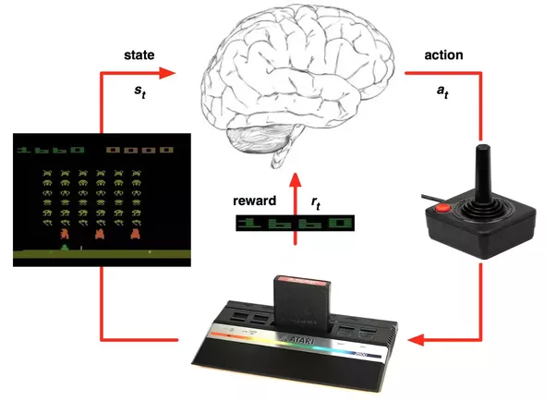
1. Abstract
Figure 1

Slide 3
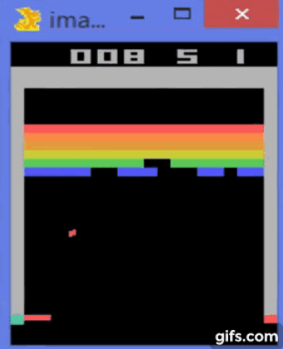
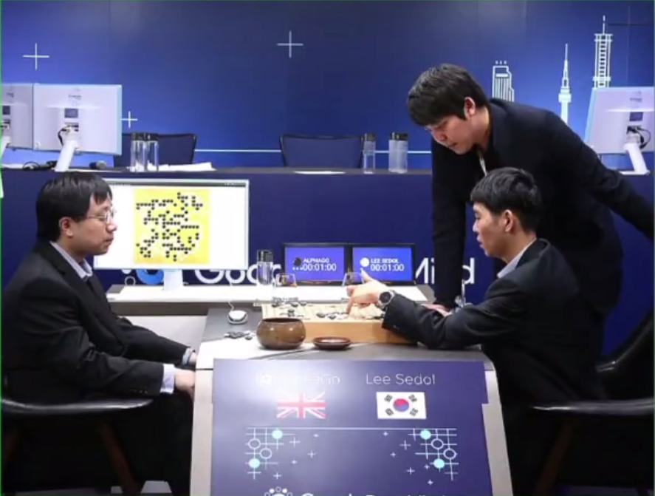
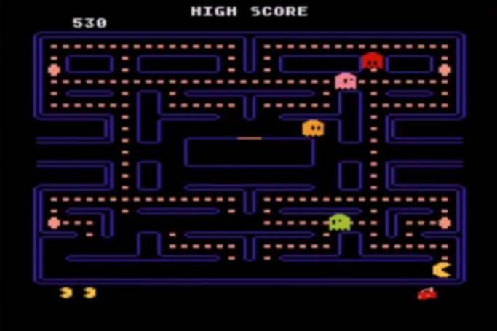
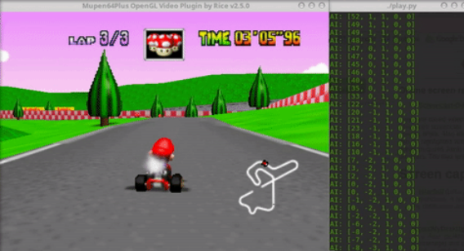

2. Introduction
Figure 2

Slide 4
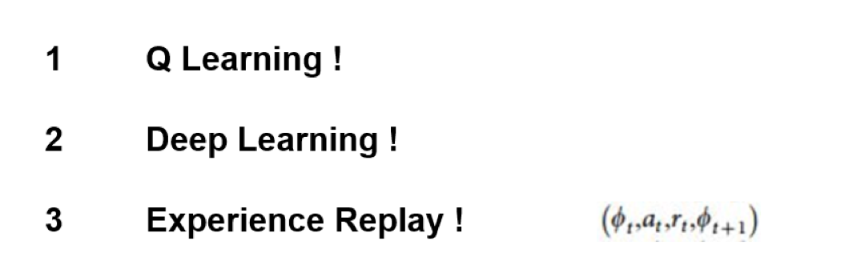
3. Deep Q-learning Network(DQN)
- Important Components

Slide 5
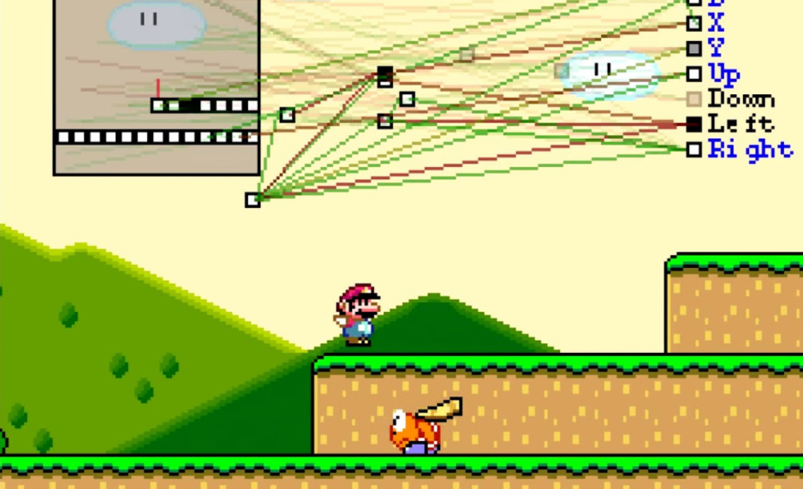
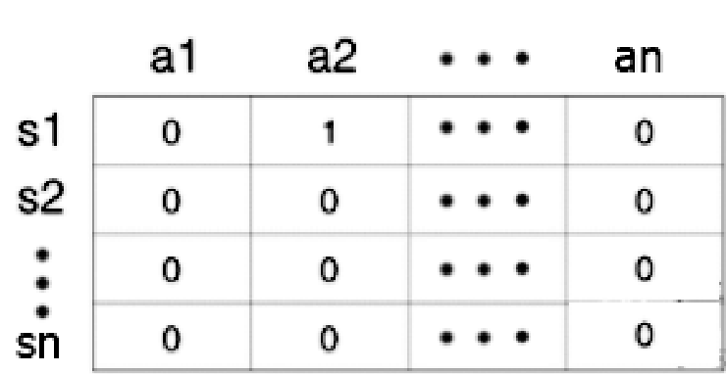

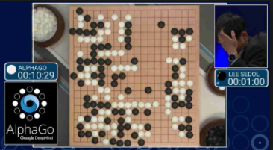
4. Q Learning
210x160
How many states ?
astronomical number
* RAM
* Updated data
* Getting data

Slide 6
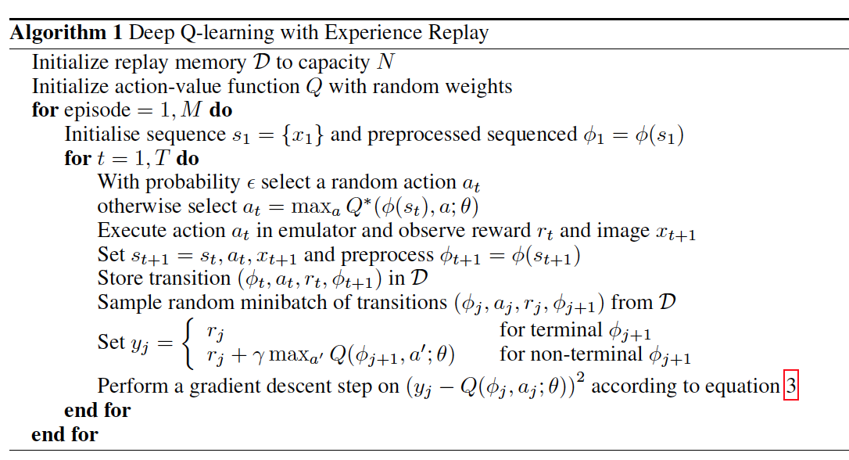
5. Deep Q-Networks
How many times the agent plays the game
Game start
Store one memory
Start learning
Backpropagation

Slide 7
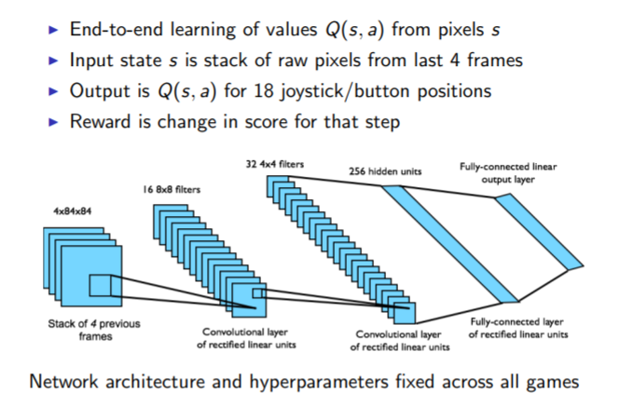
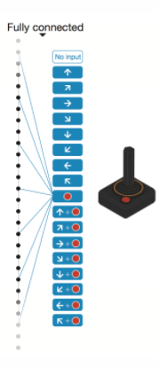
6. Preprocessing and Model Arcchitecture
Figure 3

Slide 8
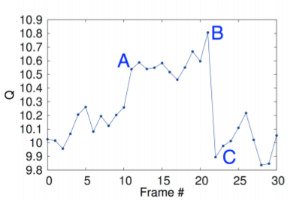
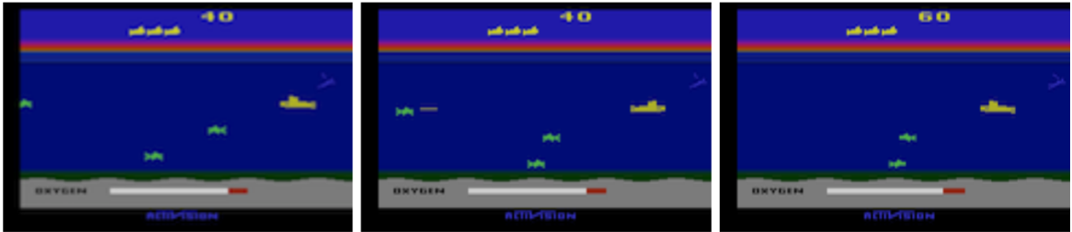
7. Visualizing the Value Function
Q-value
Figure 4

Slide 9
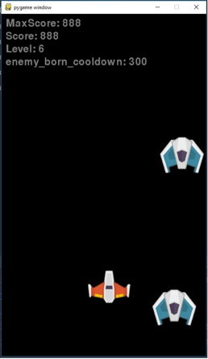
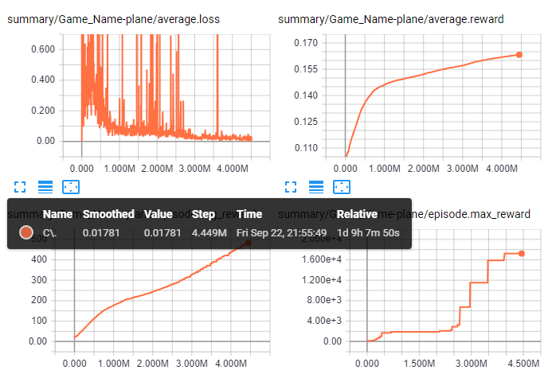
8. Demo

Slide 10
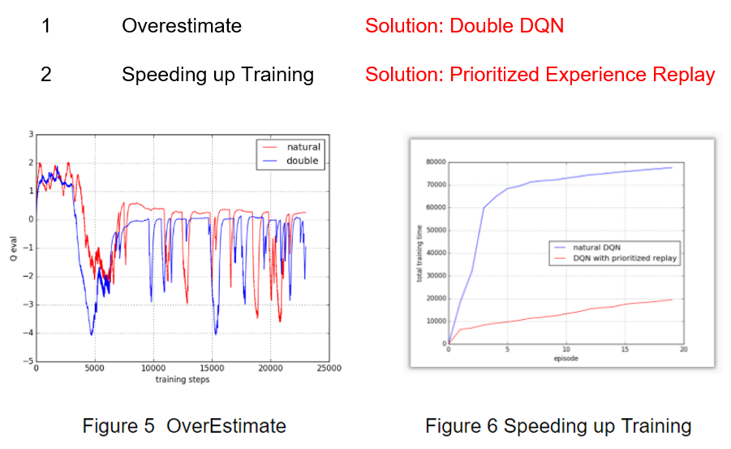
9. Future work

Slide 11
Conclusions
Deep Reinforcement Learning
Q learning
DQN
Experience Replay

